Slide 1
Neural Networks and Deep Learning Focusing on classification in NLP
FMNLP, Fall 1401
Instructor: Yadollah Yaghoobzadeh
Some slides are adopted from “ML for NLU” course of Sam Bowman (NYU)

Slide 2
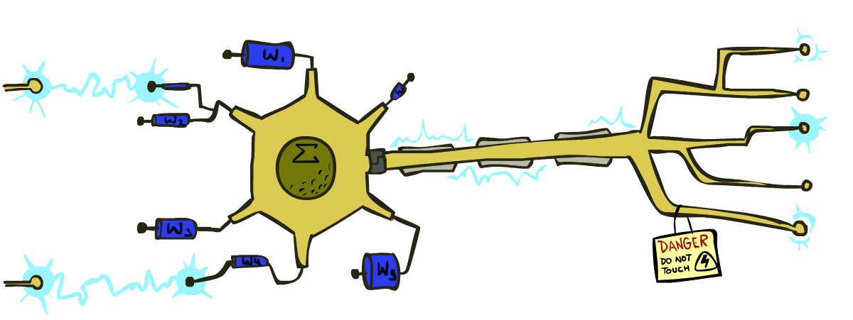
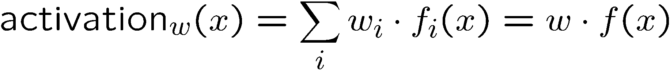
Linear Classifiers
Inputs are feature values
Each feature has a weight
Sum is the activation
If the activation is:
Positive, output +1
Negative, output -1
w₁
f₁
Σ
w₂
>0?
f₂
w₃
f₃

Slide 3
How to get probabilistic decisions?
Activation:
If very positive → want probability going to 1
If very negative → want probability going to 0
Sigmoid function

Slide 4
Best w?
Maximum likelihood estimation:
with:
= Logistic Regression

Slide 5

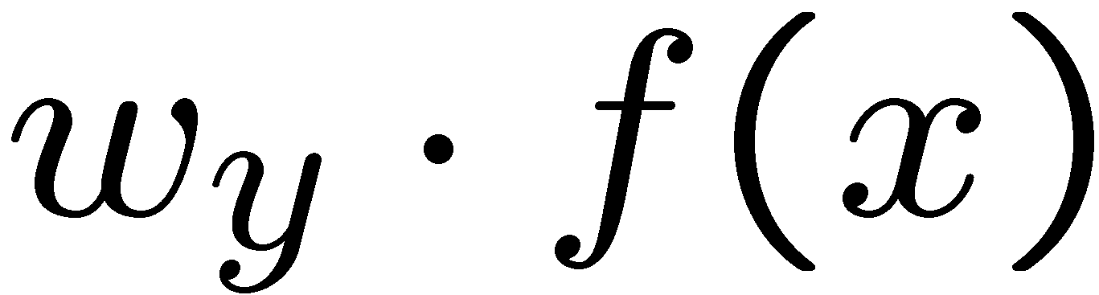
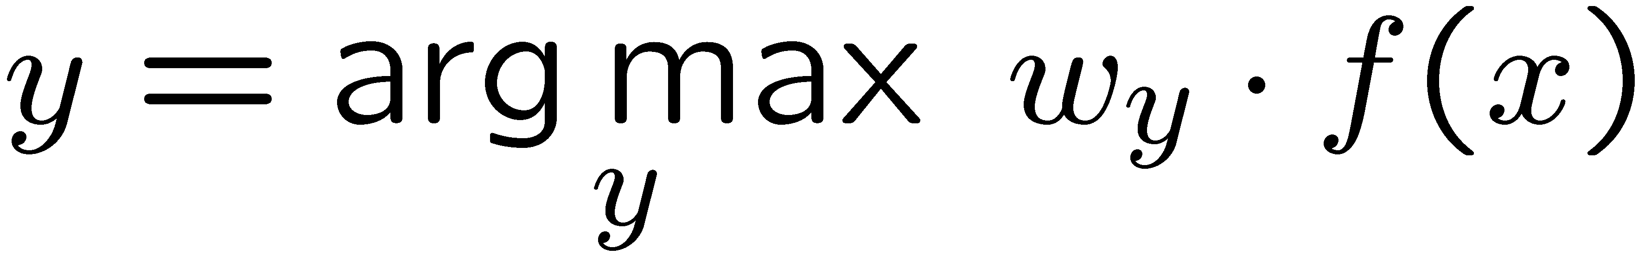
Multiclass Logistic Regression
Multi-class linear classification
A weight vector for each class:
Score (activation) of a class y:
Prediction w/highest score wins:
How to make the scores into probabilities?
original activations
softmax activations

Slide 6

How do we make nonlinear classifiers out of perceptrons?
Build a multi-layer neural network!

Slide 7
Multi-class Logistic Regression
= special case of neural network
f₁(x)
z₁
softmax
f₂(x)
z₂
f₃(x)
…
z₃
f_{K}(x)

Slide 8
Deep Neural Network = Also learn the features!
x₁
f₁(x)
softmax
x₂
f₂(x)
…
x₃
f₃(x)
…
…
…
…
…
x_{L}
f_{K}(x)
g = nonlinear activation function

Slide 9
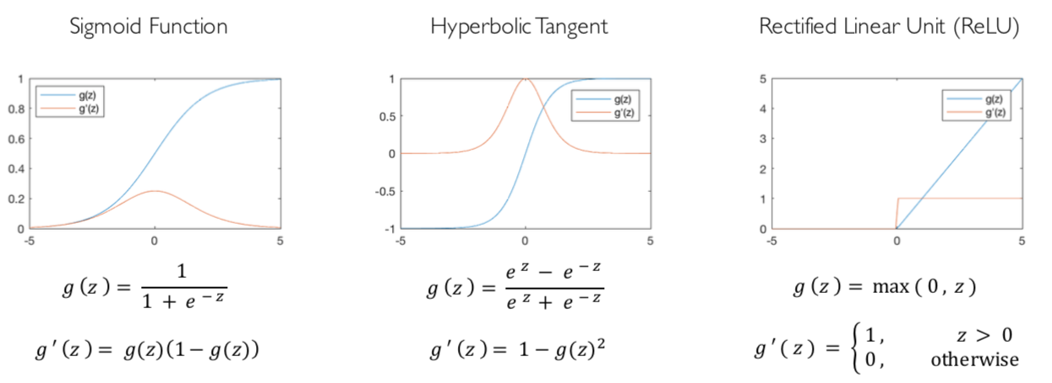
Common Activation Functions
[source: MIT 6.S191 introtodeeplearning.com]

Slide 10
Deep Neural Network: Training
Training the deep neural network:
Using gradient descent algorithm

Slide 11
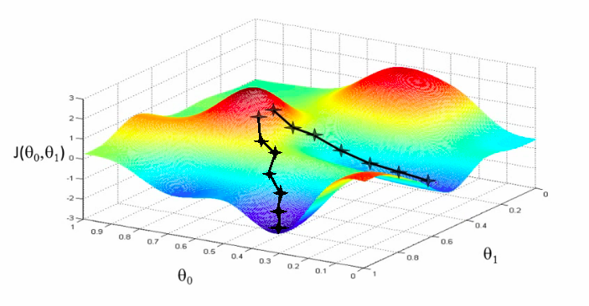
Deep Neural Network: Training
Update weights by gradient descent:
w₂
w₁

Slide 12
Deep Learning for Text Classification

Slide 13

Text classification example: sentiment analysis
Given a piece of text, predict the sentiment

Slide 14
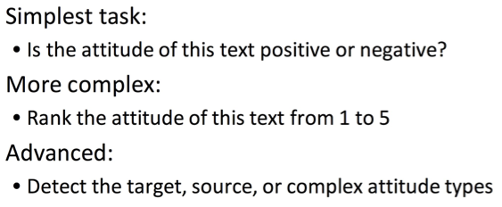
Sentiment analysis

Slide 15
Sentiment analysis

Slide 16
Classification
Output a choice from a fixed set of labels
For sentiment:
Positive/negative
Star rating
…

Slide 17
Building a classifier
Let’s say we have 10k labeled sentences
We want to learn a function f that
maps an unseen sentence to one of the labels

Slide 18
Classification with supervised learning
Collect some example input-label pairs (x,y)
Design a model that can map inputs to labels and whose behavior depends on the values of some parameters θ.
Use a learning algorithm to train or fit the parameters θ to the input-label pairs (x,y)
this usually involves optimization: picking parameters that perform best (according to some measure of performance) at predicting the labels from the inputs.

Slide 19
From strings to words
I don’t like any of Ford’s trucks.
I do n’t like any of Ford ‘s trucks .
Tokenization: Turning strings into a sequence of symbols (e.g., words, subwords, characters, etc)

Slide 20
Features: two views
Statistical NLP view
Deep learning view

Slide 21
Evaluating a Two-Class Classifier

Slide 22
Training supervised classifier
We usually need to use regularization to avoid overfitting
early stopping could be used as well.
We split data into train, dev, test
Normally all subsets are from the same distribution
The hyperparameters of the models are chosen using the dev set

Slide 23
NN sentiment classifier

Slide 32
What are NNs made of?

